Slide 1
Processes
Operating System Lab-in-a-Box

Slide 2
Lecture Contents
Process– What is it
Memory lay out
Switching between Processes
RTX and Linux Examples
Process Termination
Context Switching and States
Notes:
The next set of slides will cover the following topics: What a process is, basic view of memory layout, how switching between processes is achieved, some examples from Linux and RTX, how to terminate a process, the concepts of context switching and various states of process.

Slide 3
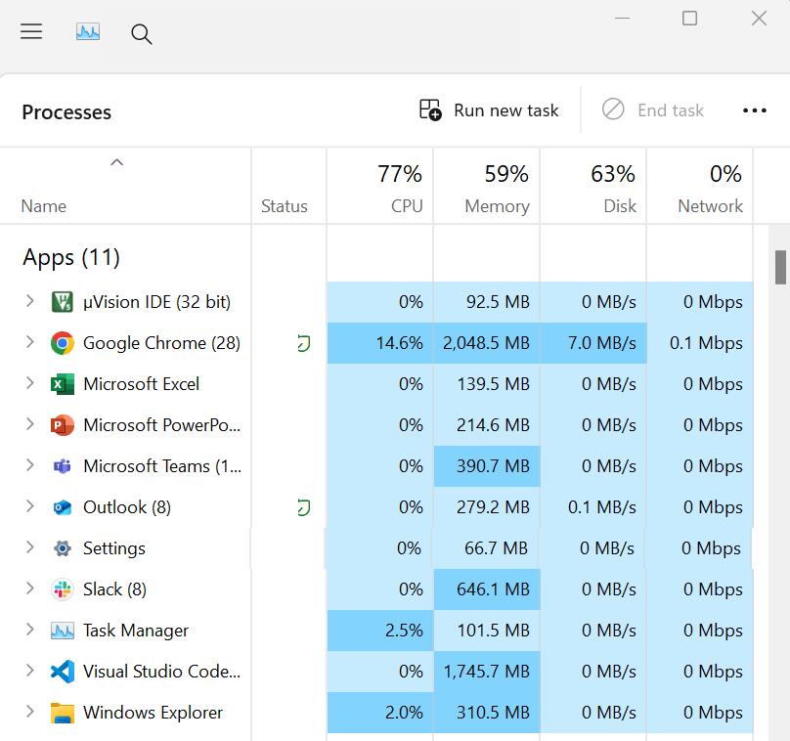
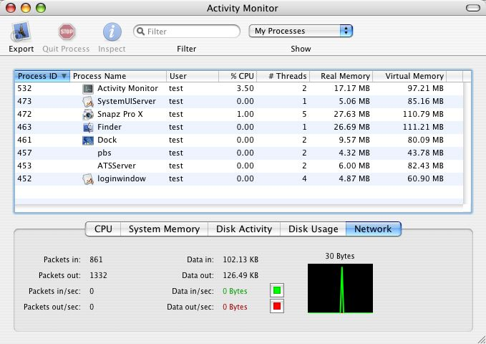
An Instance of a Running Program
Multiple instances of the µVision5
Independent memory for each process
“Memory(Private Working Set)”
Try to explore the task manager, activity monitor, or similar utility on your favourite OS
Notes:
If you are using a PC with Windows, you will be able to see the “Task Manager”. You will see a number of processes running and some information about them such as: username, various instances of the process and its memory use.
If you are using a Mac, press Command + space bar and type “Activity manager” to see the processes running in the Mac.

Slide 4
An Instance of a Running Program
A process can have
A CPU time allocation (virtual CPU, the role of OS)
Memory (real or virtual)
Process ID
Threads
Are they aware of the existence of other processes?
The operating system’s role is to create an “illusion” that a process has all it needs to be executed
An abstraction of hardware resources
Each process sees one dedicated processor and one segment of memory (although they are often shared with others)
But they can be aware of each other – inter-process communication (IPC)
Notes:
Various activities or sub programs are called processes by the operating system. A process has a run time allocation (the CPU switches between process in a time-shared manner and runs many processes at the same time). The operating system allocates memory and a process ID.
Within a process there can be a single thread or sequence of program steps or even multiple threads, depending on the hardware architecture of the CPU.
The operating system makes the process feel self-sufficient with the necessary hardware and memory resources. Processes may be aware of other running processes and be able to communicate with them with the support of OS.

Slide 5
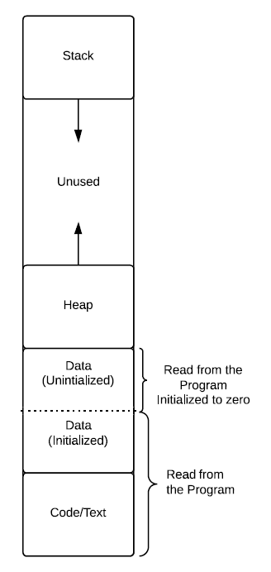
Memory Layout of an Executing Program
Code or Text
Binary instructions to be executed
A clone of the program
Usually read-only
Program counter (PC), points to the next instruction
Static Data
Global/Constant/Static variables - shared between threads
If not initialized by program, will be zero or null pointer
Heap
malloc/free
Stack
Used for procedure calls and return
Stack Pointer(SP)
FILO (First In, Last Out)
Notes:
The computer memory map programmer’s view is shown here. The memory contains a program with initialized data, then there is space for some reserved data locations. Next, there is memory allocated for use when a program calls “malloc” commands etc., this is the heap. Finally, there is some unused memory, then an area of memory called the “Stack”. Stack memory is used when a program/process jumps from one context to another. During this context switch, the stack is used to store return address, register values etc. The Stack pointer keeps track of the next available memory location in the stack. The stack works in a First In, Last Out (FILO) scheme. An example of this a tennis ball can, the last tennis ball being pushed into the can comes out first when balls are being taken out.

Slide 6
Process – The Abstraction
Switching between executions means the operating system has to keep track of all the execution context
Includes:
Memory State (code, data, heap and stack)
CPU state (PC, SP and other registers)
Also the OS state
Hence the abstraction of the process
Program usually refers to the instructions that are stored on disk
Process is the program with execution context
Some OSs may use the term “Thread”, particularly in an embedded system context. We will use both terms interchangeably for this course
Thread: a lightweight process; a process may have multiple threads which share the same system resources - faster creation, termination, switching and communication
Notes:
Operating systems help in switching between processes (sometimes called tasks). The memory (variable) values, program counter (PC) value, stack pointer value, and register values for each process are tracked/taken care of by the OS. A process should be run in their own context or register values etc. The OS makes sure that each process (or Thread) runs correctly with their own register values and parameter values, however a process can have multiple threads. A thread is an independent sub-program or sub-execution of the process. Multiple threads can run in parallel or run virtually in parallel, sharing resources such as memory, registers etc. The CPU hardware may support multiple threads to run in parallel by having separate registers and logic units for each thread. The parallel running of threads increases performance, i.e. reduces the run time of the process.

Slide 7
Process Control Block
The Process Control Block (PCB) or Task Control Block (TCB) maintains all the relevant information for the process:
Process ID
Process state
PC, SP and other registers (stored)
Scheduling information (priority)
Memory management information
Accounting information
User information
Inter-Process Communication (IPC)
Other information
The ID points to the entry in the process table where the pointer to the PCB is stored
Notes:
The Process Control Block (PCB) or the Task control Block keeps information about each process. The process information includes: a process ID, state, register values, scheduling information, memory allocated to the process, username of the process, and inter process communication capacity. The PCB is stored in memory and the process ID pointer shows the location.

Slide 8
Linux Example
1164 struct task_struct {
1165 volatile long state; /* -1 unrunnable, 0 runnable, >0 stopped */
1166 void *stack;
1167 atomic_t usage;
1168 unsigned int flags; /* per process flags, defined below */
1169 unsigned int ptrace;
1170
1171 #ifdef CONFIG_SMP
1172 struct llist_node wake_entry;
1173 int on_cpu;
1174 struct task_struct *last_wakee;
1175 unsigned long wakee_flips;
……
1234 /* task state */
1235 int exit_state;
1236 int exit_code, exit_signal;
1237 int pdeath_signal; /* The signal sent when the parent dies */
1238 unsigned int jobctl; /* JOBCTL_*, siglock protected */
1239
1240 /* Used for emulating ABI behavior of previous Linux versions */
1241 unsigned int personality;
1242
1243 unsigned in_execve:1; /* Tell the LSMs that the process is doing an
1244 * execve */
1245 unsigned in_iowait:1;
1246
1247 /* task may not gain privileges */
1248 unsigned no_new_privs:1;
1249
1250 /* Revert to default priority/policy when forking */
1251 unsigned sched_reset_on_fork:1;
1252 unsigned sched_contributes_to_load:1;
1253
1254 pid_t pid;
1255 pid_t tgid;
……
1577 #ifdef CONFIG_UPROBES
1578 struct uprobe_task *utask;
1579 #endif
1580 #if defined(CONFIG_BCACHE) || defined(CONFIG_BCACHE_MODULE)
1581 unsigned int sequential_io;
1582 unsigned int sequential_io_avg;
1583 #endif
1584 };
linux3.14:http://lxr.free-electrons.com/source/include/linux/sched.h
Notes:
This slide contains a Linux example of a TASK control Block. It starts at line 1164 and runs till line 1584. In the block, the characteristics and operations allowed for the task are defined.

Slide 9
CMSIS-RTOS2 Example
#include "cmsis_os2.h"
// Task function
void BlinkyThread(void *argument) {
while (1) {
Toggle_LED();
osDelay(500);
}
}
// Define Thread attributes (like parts of a TCB)
const osThreadAttr_t blinkyAttr = {
.name = "BlinkyThread", // Name (metadata)
.priority = osPriorityNormal, // Priority
.stack_size = 512 // Stack size in bytes
};
// Create Thread (TCB is created internally)
osThreadId_t blinky_id;
void main_app(void) {
osKernelInitialize();
blinky_id = osThreadNew(BlinkyThread, NULL, &blinkyAttr);
osKernelStart();
}
We will come back to this later
Check with the source code yourself - not really as intimidating as you might expect!
Notes:
In this slide, a CMSIS-RTOS v2 example is shown for creating a Thread. Instead of manually defining a Task Control Block (TCB), we use the osThreadAttr_t structure to describe task characteristics such as its name, priority, and stack size. The actual TCB is created and managed internally by the RTOS when osThreadNew() is called. This high-level API makes task creation simpler and portable across different RTOS kernels like RTX5 and FreeRTOS.

Slide 10
Process Creation
By initialization, by request of a process, or by request of a user
Unique ID for the process
init_task_pid() in Linux
Allocate memory for the PCB and other control structures (kernel) and user memory
Initialize the PCB and memory management
Link the PCB in the queue (see later)
Notes:
A process can be initiated by the user or by the request of a process. The unique ID, memory allocation, initialization, memory management and linking of the process control block are created/fulfilled.

Slide 11
Process Termination
Stopped by the OS/user (why?) or terminate itself
Handle the output of the process
Release the resources and reclaim the memory
Unlink the PCB
In embedded software, some processes may never terminate. Terminating implies a fault.
Notes:
Processes (or task) are terminated by the OS, the user, or the process may terminate itself after completing a task. The output of the task on its completion is taken care of on termination. Whilst the process is terminating, the resources and memory allocated to the process on creation are released and the PCB is unlinked. Some of the tasks do not terminate in embedded systems since the tasks run continuously.

Slide 12
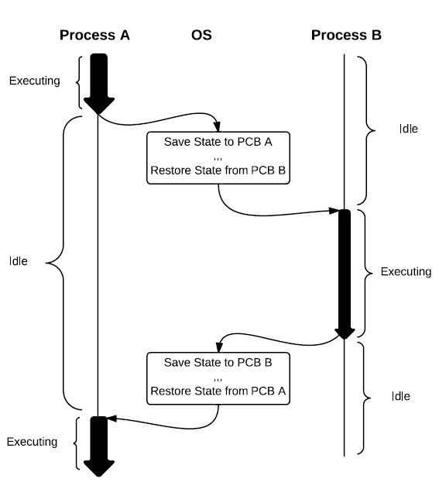
Context Switching
The PCB makes context switching a bit easier
Scheduler will start or stop a process accordingly
Stores necessary information in the PCB to stop
Hardware registers
Program Counter
Memory states, stack and heap
State
Similarly, loads necessary information from the PCB
Notice that context switching does consume time!
Could be up to several thousand CPU cycles
Overhead and bottleneck
Hardware support is also needed
Multiprogramming, although only one active process at any given time
Notes:
When a CPU switches process, the following happens: Process A stops execution and Process B starts executing. Before this switch, the states of various registers used by process A are stored in STACK memory and the register values of process available in stack for process B are restored, this is where process B starts execution. At the correct switching time, process B stops and process A starts execution. Before this switch, the states of various registers used by process B are stored in STACK memory and the register values of process available in stack for process A are restored, now process A can begin its execution. The context switching time (the time taken to load the current process states and restore the new process states) does take a lot of instruction cycles. It is considered as the overhead time for context switching. There is hardware support available in order to reduce the amount of context switching time. This is multiple processes running in accordance with the concept of multiprogramming. In multiprogramming, multiple programs are switched to run on the CPU with context switching over head.

Slide 13
Process States
Different process states during the lifetime cycle
Many variants but a standard model has five states:
New: just been created, not ready for the queue
Ready: can be loaded by the OS
Running: scheduler has picked this process from the queue and executed it, usually only one
Blocked: not in the queue, waiting
Exit: finished, needs to terminate
Linux Example:
TASK_RUNNING; TASK_INTERRUPTIBLE; TASK_UNINTERRUPTIBLE; __TASK_STOPPED; __TASK_TRACED; EXIT_ZOMBIE; EXIT_DEAD; TASK_DEAD; TASK_WAKEKILL; TASK_WAKING; TASK_PARKED; TASK_STATE_MAX
Notes:
A process can be in a number of different states. Typically a process will be in one of these five states: new, ready, running, blocked and exit. In Linux, the task can be in various states as mentioned in the slide: Task_Running etc.
In the Linux example, TASK_RUNNNING state means that the process is runnable, and it is either currently running or in a run queue waiting to run. Processes may run in user state or kernel stat. The process is either executing on the CPU or waiting for the CPU to execute.

Slide 14
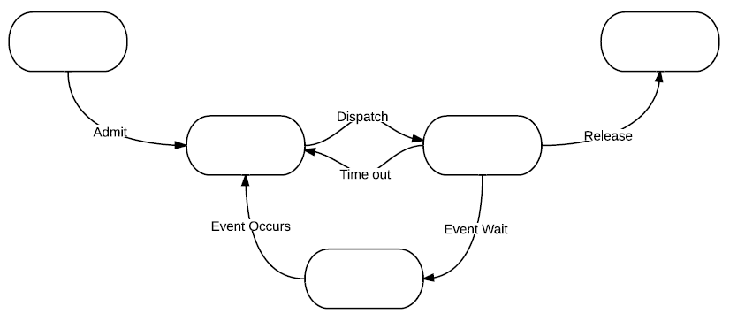
State Transition
State transition as a result of OS scheduling, external interrupts or program requests
Try to fill in the states in each block
Notes:
A task can be in any one of the states. If there are five states, then they are: new, ready, running, blocked and exit. The process transits from one state to another on some triggering event like a time out or dispatch.

Slide 15
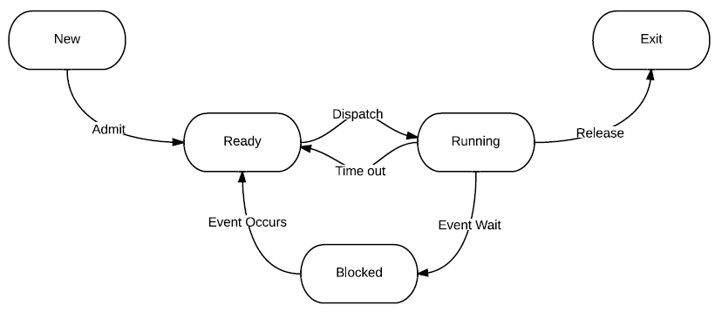
State Transition
Admit: process is fully loaded into memory and control is established
Dispatch: scheduler assigns CPU to the process
Time out: expired or preempted, pushed back to the queue
Event Wait/Event Occurs: generally requests that cannot be met at the moment, has to wait until something occurs
OS not ready for a service
Unavailable resource
Wait for an input
Release: release resources and end the process
Notes:
The five states and the trigger to transit the process from one state to the other are shown in the slide. For example, when the “admit” signal is triggered, the process moves from the “New” to “Ready” state. The “Admit” is triggered when the process is fully loaded into memory and control is established. Other triggers are explained in the slide and they are: Event occurs, event wait, dispatch, time out, admit, and release.

Slide 16
Process State
State information is also recorded by the PCB
Context switch takes place whenever a process leaves/enters the running state
Processes may make a transition voluntarily or involuntarily, e.g., end the program vs error
OS typically maintains queue or queue-like (list) structures for processes in the same states (many pointers in the PCB)
More complicated models possible:
Some processes are stored in the secondary storage in their Ready or Blocked states
“Suspended” Ready and Blocked – the seven states model
To support swapping
Scheduler prefer those sit in main the memory
Notes:
The process state is recorded by the Process Control Block (PCB). The process can be in one of the five states. When a process leaves or enters “Running” state, the context switch happens. Remember that the context switch involves storing and restoring of values from stack and consumes time. The OS maintains the queue structure for the processes in the same states. There are also more complicated models possible depending on the number of states (instead of Five, there can be 7 states).

Slide 17
RTOS Thread States
typedef enum {
osThreadInactive = 0, // Not created or terminated
osThreadReady = 1, // Ready to run
osThreadRunning = 2, // Currently running
osThreadBlocked = 3, // Waiting (delay, semaphore, etc.)
osThreadTerminated = 4 // Has been deleted
} osThreadState_t;
No Exit state
Embedded software don’t really enjoy the concept of termination
More on this in later lectures and labs
Notes:
This slide shows standard Thread states used in CMSIS-RTOS v2. A task can be:
Inactive: Created but not yet started, or terminated
Ready: Waiting for CPU time
Running: Actively executing
Blocked: Waiting for an event (e.g., delay, semaphore, flag)
Terminated: Deleted via osThreadTerminate()
The RTOS uses internal queues to manage transitions between these states. These states apply to both FreeRTOS and RTX5 when using the CMSIS-RTOS v2 API.

Slide 18
Next
Lab
Set up the IDE and get you familiar with C and assembly (if not already)
Context switching at processor level
Basic FreeRTOS task operations
Scheduling
Notes:
Next we will do the lab and learn about Scheduling.

